Slide 1
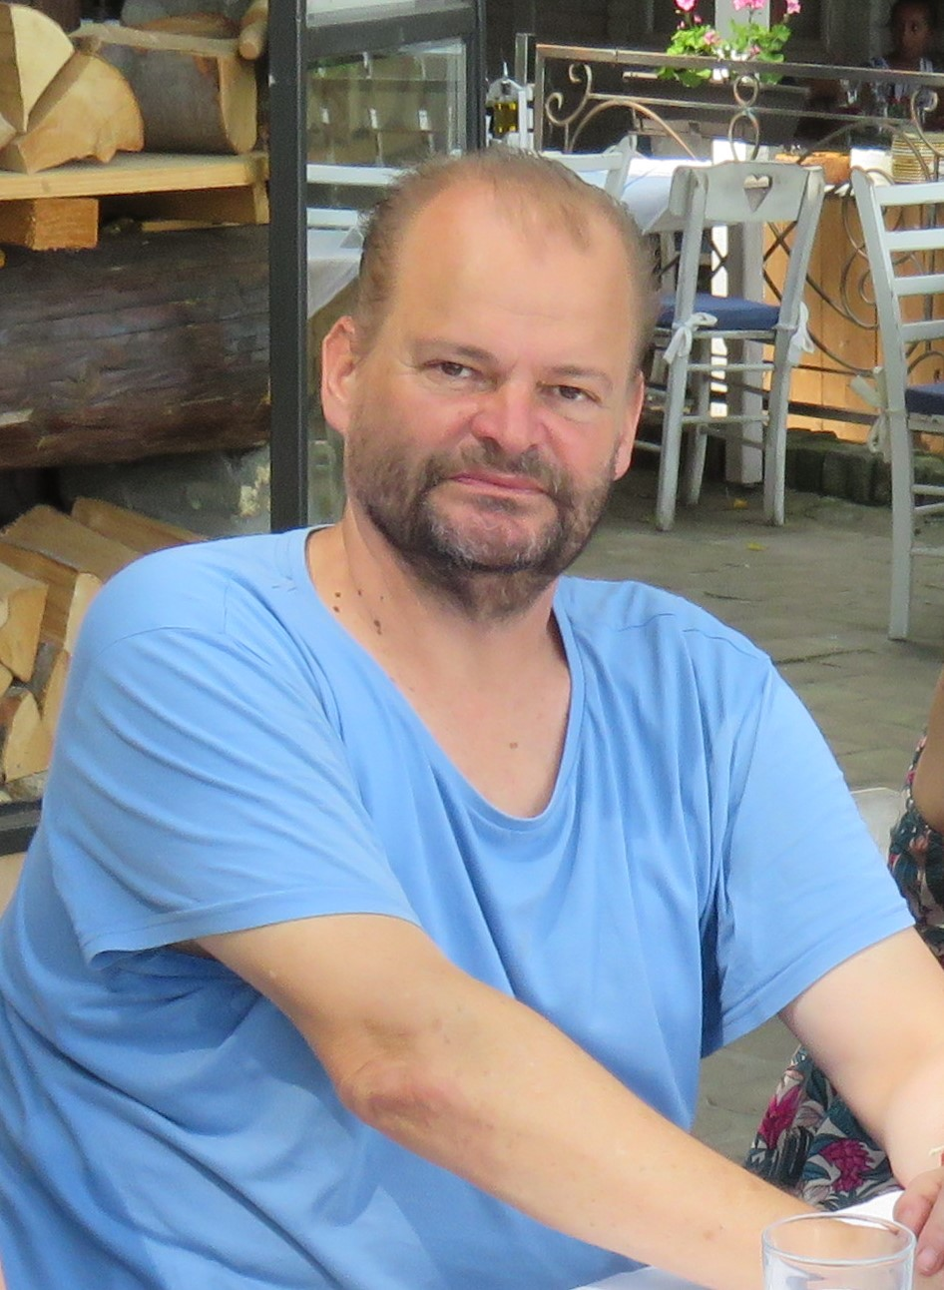
Zoran Budimac
1960 - 2023
29th August 2023
Notes:
Passed away only some days ago

Slide 2
Zoran Budimac
Full professor at the
Department of Mathematics and Informatics Faculty of Science University of Novi Sad
Since 2004
Notes:
Passed away only some days ago

Slide 3
Zoran Budimac
One of the initiators of our DAAD projects:
Host of 1st DAAD workshop at Novi Sad in 2001 and 10th workshop at Ivanjica in 2010
His idea: create a pool of Joint Course Materials for Software Engineering (JCSE)
Hard-working all the time
Good friend
Initiator of a TEMPUS project (co-grantholder: HU)
Joint Master in Software Engineering
Of course, only some ideas from my (cooperation) side …

Slide 4
Zoran Budimac
1960 - 2023
A minute of silence

